Slide 1
BERT and Transformer Model
Presented by:
P. Tejasri-192472069
Guided by:
Dr. V K Gnanavel

Slide 2
Introduction to NLP
Natural Language Processing (NLP) is a branch of Artificial Intelligence that enables computers to understand and process human language.
Traditional NLP models had limitations in understanding the context of long and complex sentences.
The Transformer architecture, introduced in 2017, revolutionized NLP with its self-attention mechanism.
BERT (Bidirectional Encoder Representations from Transformers), developed by Google in 2018, further improved language understanding by analyzing text in both directions.
BERT and Transformer models have significantly enhanced the accuracy and efficiency of various NLP tasks.
Today, they are widely used in applications such as search engines, chatbots, machine translation, sentiment analysis, and virtual assistants.

Slide 3
What is a Transformer?
A Transformer is a deep learning architecture designed for processing and understanding sequential data, especially natural language.
It was introduced by Google researchers in 2017 through the paper "Attention Is All You Need."
Unlike traditional models such as RNNs and LSTMs, Transformers process all words in a sentence simultaneously (in parallel), making them faster and more efficient.
The core feature of a Transformer is the Self-Attention Mechanism, which helps the model identify the importance of each word based on its relationship with other words in the sentence.
A Transformer consists of two main components: the Encoder, which understands the input, and the Decoder, which generates the output.
Transformers are widely used in modern AI applications such as BERT, GPT, Google Translate, ChatGPT, and text summarization systems.

Slide 4
Transformer Architecture
Input Sentence
Token Embedding
Positional Encoding
Encoder Layers
(Self-Attention + Feed Forward)
Context Representation
Decoder (for generation tasks)
Output Sentence

Slide 5
What is BERT?
BERT stands for Bidirectional Encoder Representations from Transformers.
It is a pre-trained deep learning model for Natural Language Processing (NLP), developed by Google in 2018.
BERT is built on the Transformer encoder architecture and uses the self-attention mechanism to understand language.
Unlike traditional models, BERT reads text in both directions (left-to-right and right-to-left), allowing it to understand the full context of a word in a sentence.
It is first pre-trained on a large text corpus and then fine-tuned for specific NLP tasks.
BERT is widely used in applications such as question answering, sentiment analysis, text classification, search engines, chatbots, and machine translation.

Slide 6
How BERT Works
Input Processing The input sentence is divided into tokens (words or subwords) using a tokenizer.
Word Embedding Each token is converted into a numerical vector called an embedding so the model can process it.
Bidirectional Context Understanding BERT reads the sentence from both left-to-right and right-to-left to understand the complete context of each word.
Self-Attention Mechanism BERT uses self-attention to identify the relationships between words and determine which words are most important.
Contextual Representation It creates a context-aware representation for every word, capturing its meaning based on the surrounding words.
Fine-Tuning for Specific Tasks The pre-trained BERT model is fine-tuned for tasks such as question answering, sentiment analysis, text classification, named entity recognition, and machine translation.

Slide 7
Applications of BERT
Search Engines
Chatbots
Question Answering Systems
Sentiment Analysis
Machine Translation
Text Summarization
Spam Detection
Healthcare Text Analysis

Slide 8
Advantages and Limitations
Advantages
Limitations
High accuracy
Better context understanding
Handles long sentences effectively
State-of-the-art performance on many NLP tasks
Large model size
Requires powerful hardware
High training time
Expensive for real-time deployment

Slide 9
Conclusion
Transformer models revolutionized Natural Language Processing by introducing the self-attention mechanism, enabling efficient and accurate language understanding.
BERT further improved NLP by understanding the context of words from both directions, leading to higher accuracy in language tasks.
Today, BERT and Transformer models are widely used in search engines, chatbots, virtual assistants, machine translation, sentiment analysis, and text summarization.
As AI continues to evolve, Transformer-based models will play a key role in developing smarter, faster, and more human-like language applications.

Slide 10
THANK YOU!

Slide 11
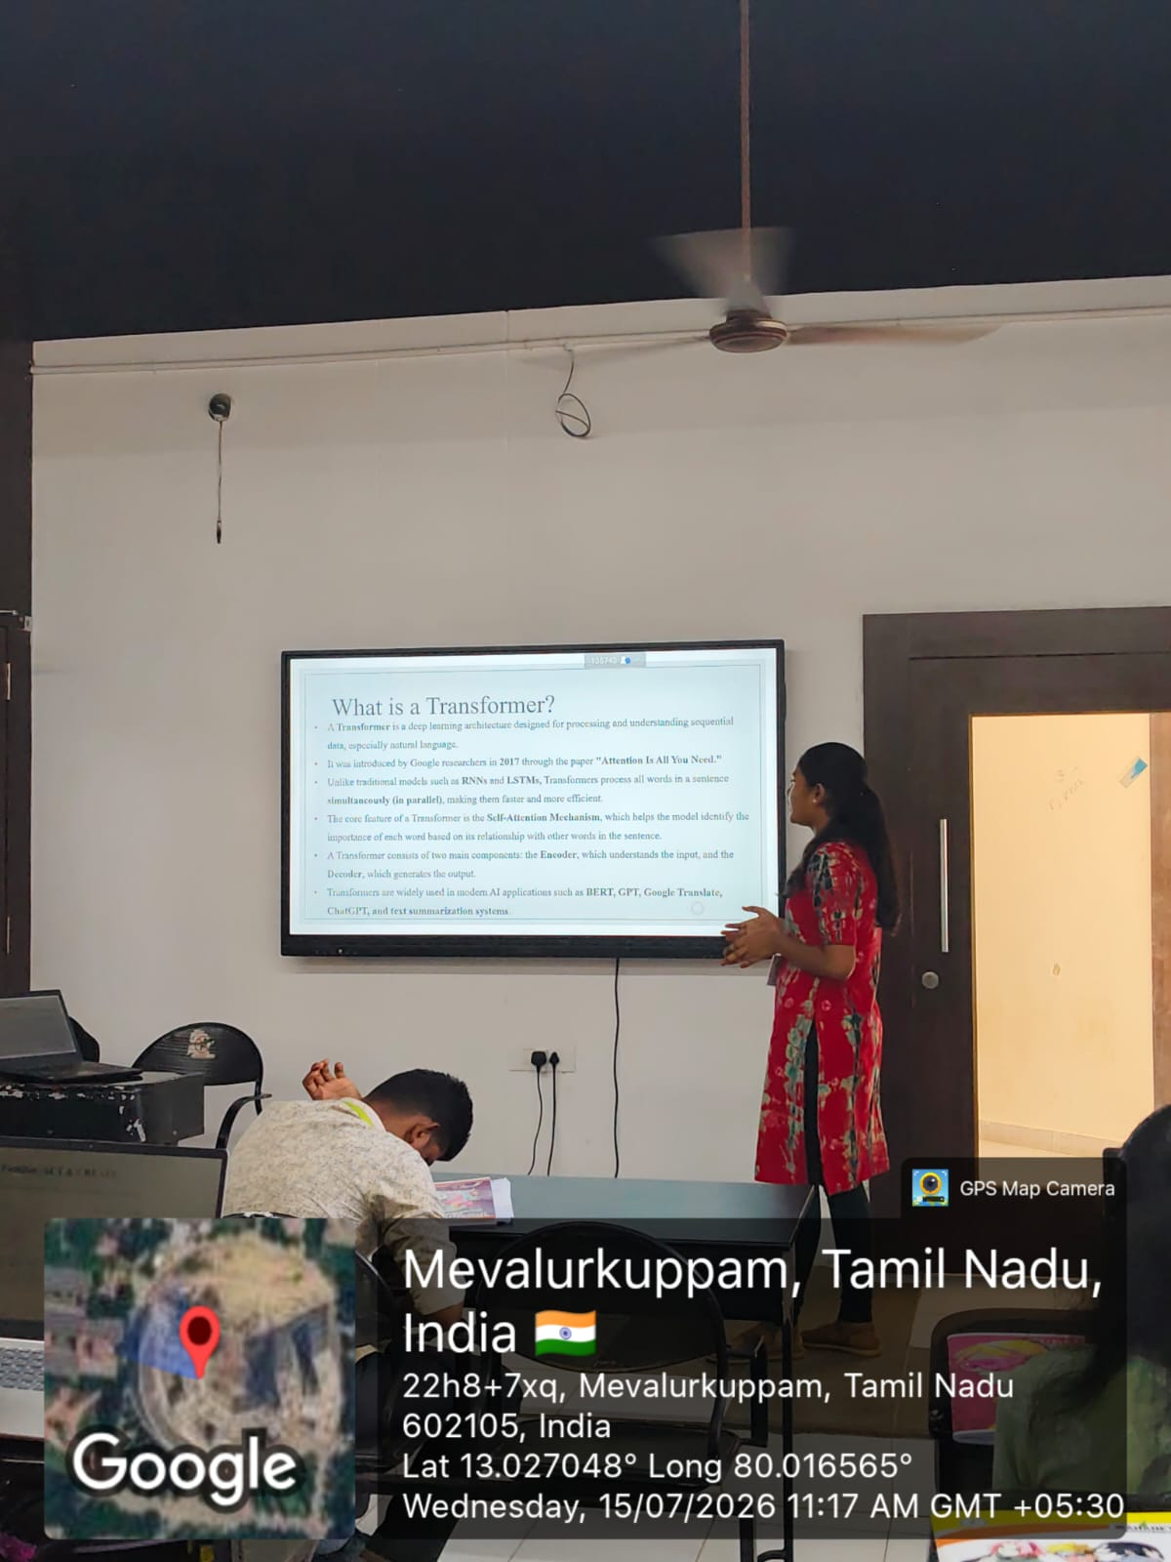
Geotag Photo:

